Slide 1


Slide 2
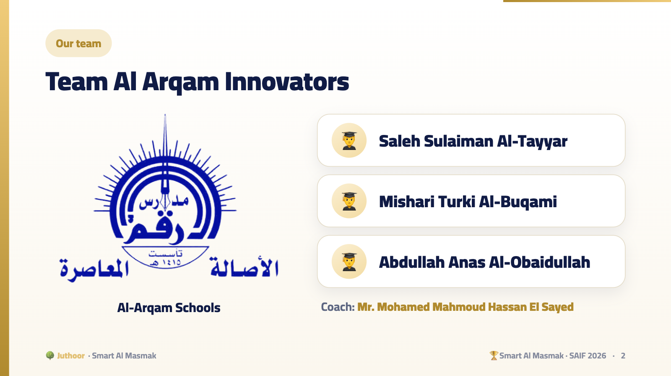
Notes:
No narrator: each student introduces himself in one sentence, live.

Slide 3
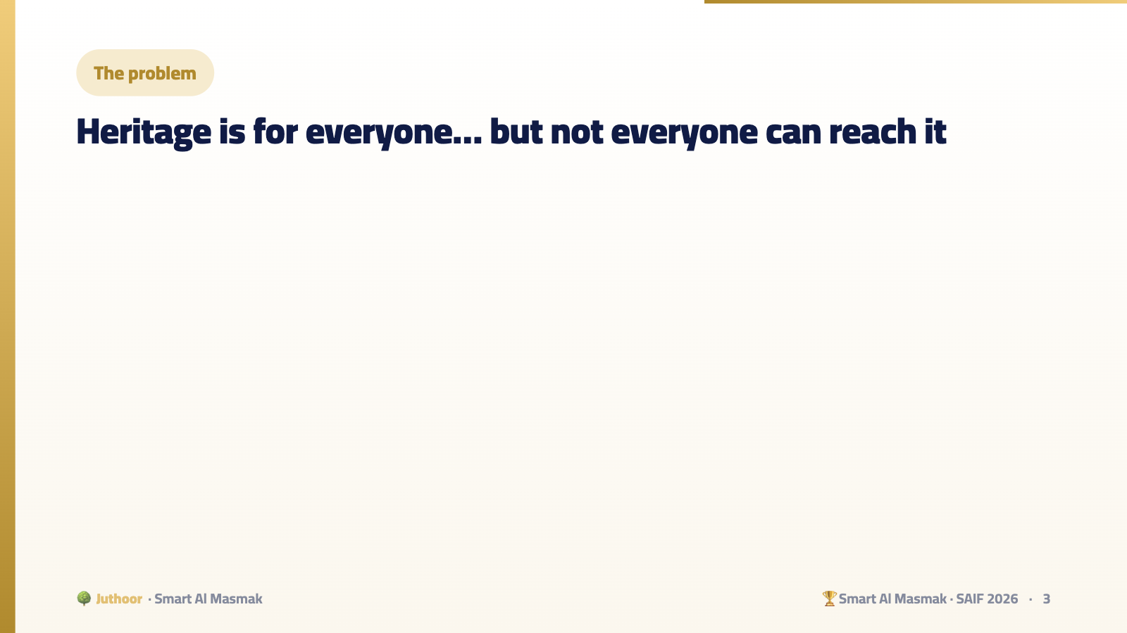

Slide 4
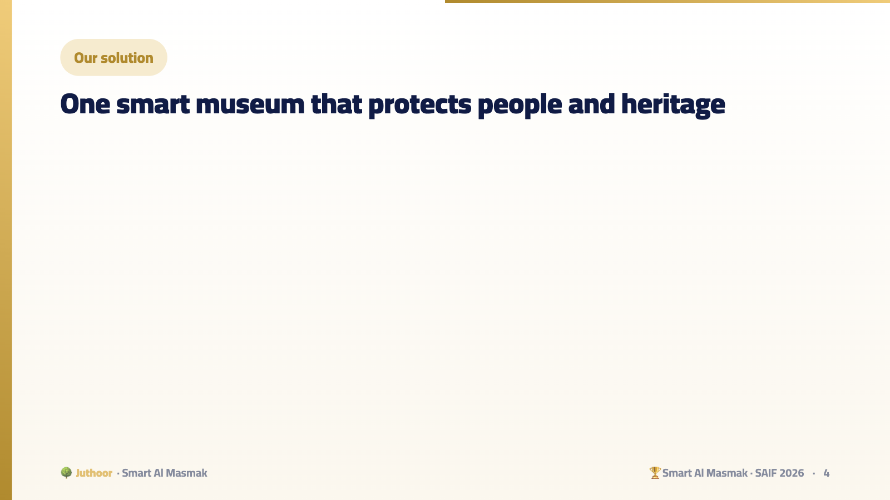

Slide 5
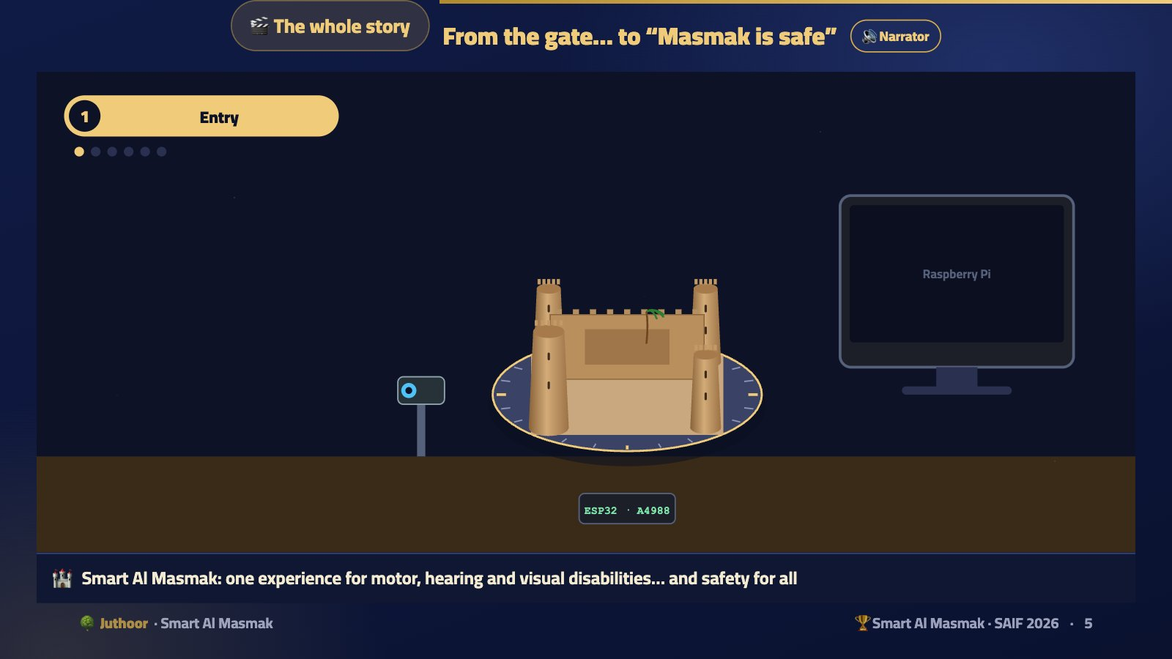
Notes:
Plays first in front of the judges, with the English narrator (in PowerPoint it is a video that starts by itself; on the web press 🔊 Narrator). Chapter 0: the visitor in the LEGO wheelchair, the camera welcomes him, his eyes turn the fortress right and left with the light wave, he holds his gaze and gets sign language + audio narration together, and a blink or the watchdog stops the turntable. Then the safety station: (1) fire only: the leader puts it out and backs up. (2) gas only: the leader gives robot 2 permission. (3) fire and gas: leader to the fire, robot 2 to the gas + Telegram. (4) a fire too big: “we need help”, and the Civil Defense officer leads robots 3 and 4 by hand until “the museum is safe”. Let it run completely, then start explaining.
🎬 فيديو بصوت الراوي يبدأ وحده عند فتح الشريحة.

Slide 6
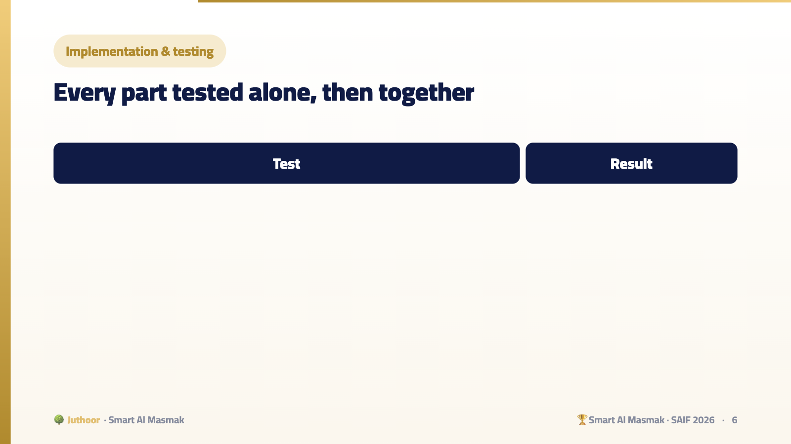

Slide 7
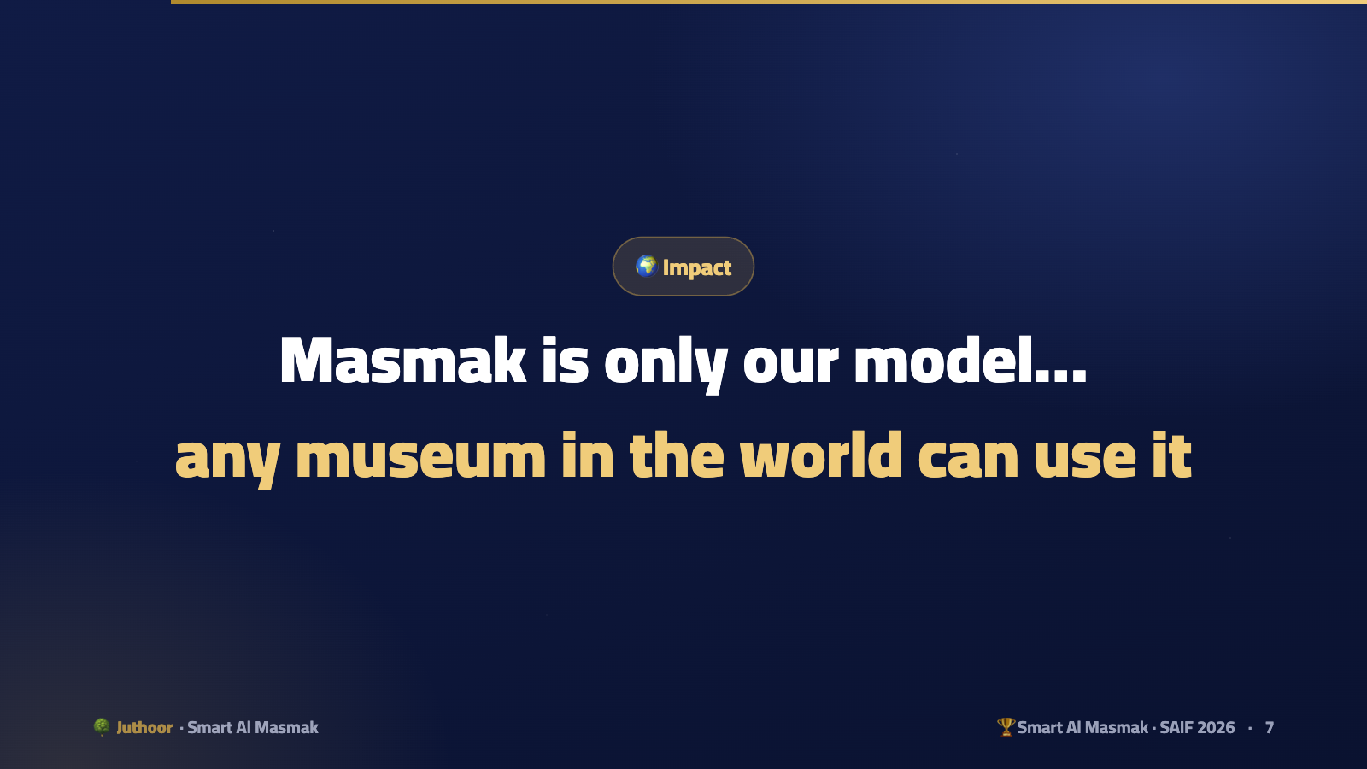

Slide 8
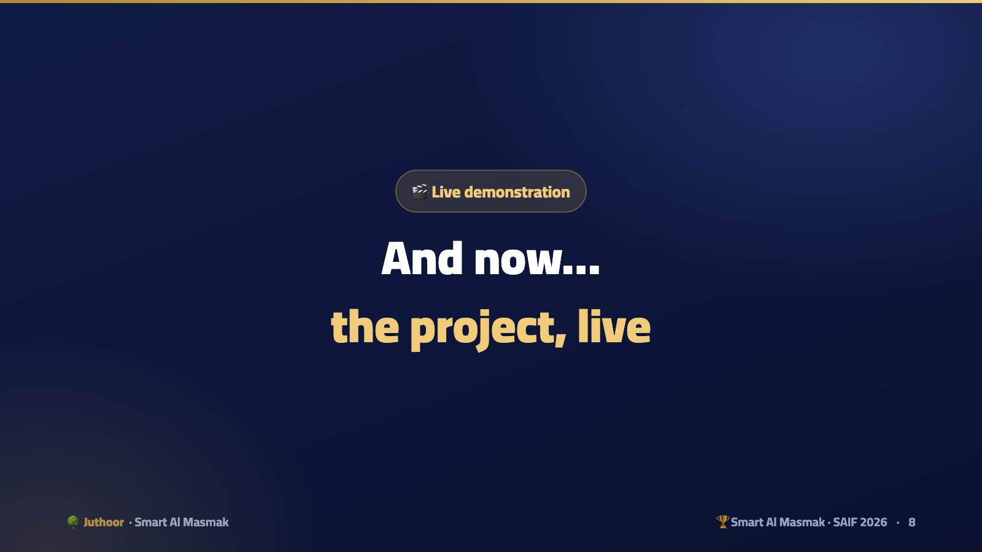
Notes:
After this slide the students run the project in front of the judges.

